Slide 1
Case study: Predicting industry returns using machine learning

Slide 2
Evidence of slow-diffusion of information across industries
Hong, Torous, and Valkanov (2007):
Investors with limited information-processing capabilities specialize in specific market segments.
When a cash flow shock arises in a particular industry, information-processing limitations prevent investors specializing in other industries from understanding the full implications of the shock.
Information diffuses gradually across industries
The resulting delayed adjustment in equity prices gives rise to cross-industry return predictability.

Slide 3
Gradual diffusion of information might give rise to profitable trading opportunities
Efficient markets response to new positive information
Stock Price
Delayed reaction to new information
0
Positive cash flow shock occurs at time 0
Time

Slide 4
Rapach et al. (2018) “Cross-Industry Return Predictability: A Machine Learning Approach”
Use machine learning techniques to identify undervalued/overvalued industries
The long/short trading strategy generates returns of over 8.4% per year with very little volatility!

Slide 5

Predictive regression framework
$y_{i}=a_{i}^{∗}ι_{T}+Xb_{i}^{∗}+ε_{i} \text{for}$ i=1,.., N
where
$$y_{i}={\left[r_{i,1}… r_{i,T}\right]}^{′}$$
$$X=\left[x_{1} … x_{N}\right]$$
$$x_{j}={\left[r_{j,0} … r_{j,T−1}\right]}^{′} for j=1,…N$$
$$b_{i}^{∗}={\left[b_{i,1}^{∗}… b_{i,N}^{∗}\right]}^{′}$$
$$ε_{i}={\left[ε_{i,1}… ε_{i,T}\right]}^{′}$$
Lagged industry returns
Industry returns
ri,t is the month-t return on industry portfolio i in excess of the one-month T-bill return
ι_{T} is a T-vector of ones,
T is the usable number of monthly observations,
N is the number of industry portfolios, and εi,t is a zero-mean disturbance term.

Slide 6
Estimation via Ordinary Least Squares (OLS)
We can estimate the predictive regression via OLS
There are 30 lagged industry returns, so overfitting is a real concern
We may also want to add some additional independent variables
An overfit regression model is too complex for the data
Overfitted models describe noise instead of any underlying relationship.
They generally have poor predictive performance on test data.

Slide 7
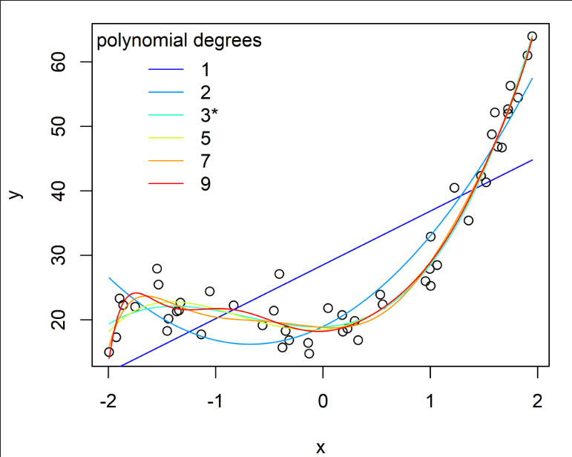
Overfitting/underfitting illustrative example in R
Consider a 3rd degree polynomial of the form:
y = 3*x³ + 5*x² + 0.5*x + 20 + random noise
Let’s fit various polynomial models to this data
*Adapted from an R-bloggers post from 5/3/2014
Notice that the model fit improves as we consider higher order polynomials

Slide 8
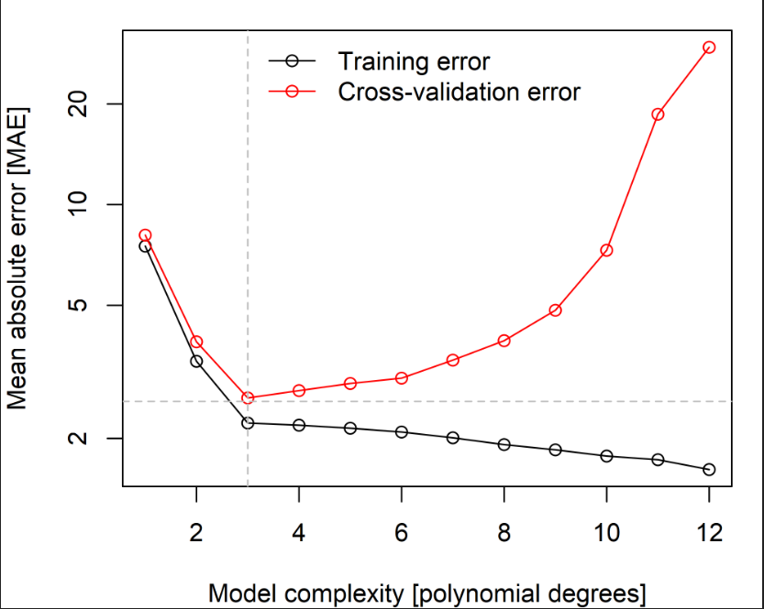
Overfitting: training versus test sets
Lower MAE in the training set with the 12th degree polynomial, but much higher error in the test set
Not surprisingly the best model in the test set is the 3rd degree polynomial

Slide 9
The Lasso
Least Absolute Selection and Shrinkage Operator
Loss
Penalty

Slide 10
Lasso, continued
The tuning parameter λ controls the strength of the penalty
If λ=0, we get the OLS estimates
If λ=∞, are just 0
For 0 < λ < ∞, we are balancing two ideas:
fitting a linear model of y on X
shrinking the coefficients.
The nature of the penalty causes some coefficients to be shrunken to be zero exactly
LASSO is able to perform variable selection in the linear model.
As λ increases, more coefficients are set to zero
among the nonzero coefficients, more shrinkage is employed

Slide 11
Lasso OLS
Fan and Li (2001): LASSO estimates of the coefficients for the selected predictors are downward biased
The LASSO penalty term overshrinks the coefficients for the selected predictors,
Effect is more severe for the most relevant predictors.
Solution proposed by Belloni and Chernozhukov (2011, 2013):
Re-estimate the coefficients for the LASSO-selected predictors via OLS

Slide 12
Data description
The data is from Ken French’s data library:
http://mba.tuck.dartmouth.edu/pages/faculty/ken.french/data_library.html
Monthly data for 30 industries from July 1926 to present
Consistent with Rapach et al. (2018), estimate the model using data from 1960 to 2018

Slide 13
Data snapshot
Subset of the 30 Fama-French industries
Date | Food | Beer | Smoke | Games | Books | Hshld | Clths | Hlth | Chems | Txtls | Cnstr | Steel | FabPr | ElcEq
1/29/1960 | -4.16 | -5.38 | -1.72 | 1.54 | -5.14 | -7.51 | -8.20 | -6.35 | -9.70 | -4.44 | -6.34 | -9.05 | -4.09 | -11.97
2/29/1960 | 3.64 | -1.85 | 2.56 | 4.52 | 2.68 | 9.60 | 1.73 | 0.27 | -0.45 | 0.61 | 3.36 | -1.74 | -1.84 | 5.40
3/31/1960 | -1.32 | -2.59 | 0.17 | -0.30 | 2.53 | -0.21 | -2.24 | 1.61 | -2.40 | -6.44 | -0.43 | -5.23 | -3.23 | -0.54
4/29/1960 | 1.36 | -1.97 | 1.54 | 6.65 | -0.98 | -1.08 | 0.40 | 1.68 | -5.34 | -0.91 | -1.26 | -5.34 | -3.91 | -0.92
5/31/1960 | 8.47 | -0.25 | 2.71 | 7.55 | 11.94 | 8.01 | 2.01 | 13.77 | 3.67 | 2.37 | 3.45 | 2.62 | 1.19 | 6.75
6/30/1960 | 5.63 | 0.71 | 4.97 | 2.48 | 0.26 | 6.62 | -1.35 | -0.16 | 0.69 | 4.28 | 2.78 | 1.56 | 1.87 | 0.04
7/29/1960 | -1.98 | -0.66 | 4.73 | -4.59 | 0.36 | -0.47 | -0.97 | -3.86 | -6.67 | -3.01 | -5.04 | -2.25 | -3.76 | -6.83
8/31/1960 | 4.74 | 3.41 | 5.37 | 7.33 | 3.80 | 5.26 | 3.51 | 2.46 | 1.34 | -0.67 | 0.74 | 0.80 | 0.97 | -0.87
9/30/1960 | -3.72 | -4.84 | -1.93 | -2.17 | -6.04 | -9.02 | -4.07 | -8.71 | -6.54 | -5.09 | -4.87 | -8.08 | -5.53 | -10.30
10/31/1960 | 1.24 | 0.76 | 4.09 | 0.33 | 2.60 | 6.70 | -3.28 | -3.49 | -1.37 | -2.84 | -1.19 | -2.13 | -1.20 | -3.36
11/30/1960 | 9.59 | 6.70 | 5.57 | 14.04 | 10.24 | 9.26 | 3.28 | 4.04 | 4.38 | 2.17 | 6.75 | 1.40 | 8.41 | 5.35
12/30/1960 | 4.67 | -0.15 | 3.70 | 7.93 | 7.57 | 1.92 | 3.44 | 6.22 | 3.01 | 0.68 | 4.43 | 4.95 | 4.95 | 1.18
1/31/1961 | 4.89 | 5.42 | 8.96 | 0.75 | 9.66 | 4.55 | 6.13 | 6.05 | 6.65 | 11.40 | 5.85 | 8.49 | 6.14 | -0.40
2/28/1961 | 4.35 | 8.30 | 5.55 | 22.47 | 2.29 | 6.04 | 7.98 | 5.19 | 2.27 | 6.95 | 4.93 | 5.88 | 9.17 | -0.15
Monthly return data

Slide 14
LassoOLS
LassoOLS in R:
LassoOLS computes the two-stage estimator Lasso+OLS (default) or the Lasso estimator (if OLS=FALSE).
Part of the HDCI library
Format:
LassoOLS(x, y, OLS = TRUE, lambda = NULL, fix.lambda = TRUE, cv.method = "cv", nfolds= 10, foldid, cv.OLS = TRUE, tau = 0, parallel = FALSE, standardize = TRUE, intercept = TRUE, ...)
Use mypredict(obj, newx) to generate the forecast
LassoOLS in Python: sklearn-Lasso, LassoCV

Slide 15
Estimating the model: Time-series cross validation
The approach in Rapach et al (2018):
Use data from 1960:01 through 1969:12 to estimate the predictive regression for each industry via Lasso
Generate a set of 30 out-of-sample industry excess return forecasts for 1970:01.
Sort the industries in ascending order according to the excess return forecasts and form equal-weighted quintile portfolios
Create a zero-investment portfolio that goes long (short) the top (bottom) quintile portfolio.
Repeat the process using data from 1960:01 to 1970:01 to compute an updated set of out-of-sample industry excess return forecasts for 1970:02
Create a zero-investment portfolio that goes long (short) the top (bottom) quintile portfolio.
Continue this process through 2018:06

Slide 16
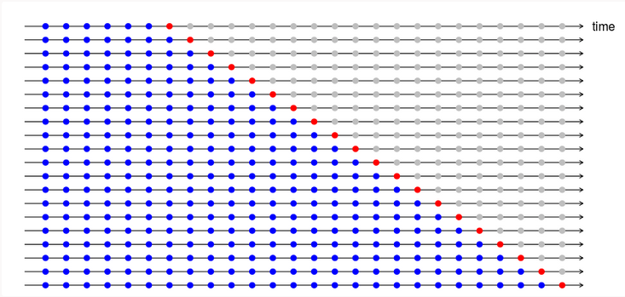
Graphical depiction of the estimation strategy
The blue observations form the training sets, and the red observations form the test sets.

Slide 17
The industry trading strategy
At the end of each month, sort the 30 industry portfolios according to out-of-sample forecasts of their excess returns for the subsequent month.
Then form equal-weighted quintile portfolios based on the sorts, and each long-short industry-rotation portfolio is a zero-investment portfolio that goes long (short) the top (bottom) quintile portfolio.

Slide 18
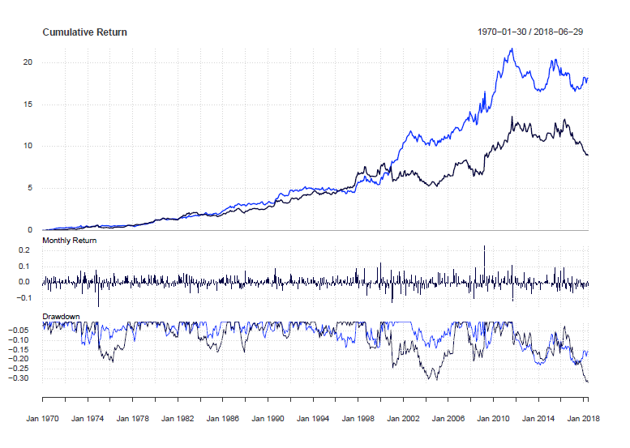
Trading strategy performance: OLS vs. Lasso Forecasts
LassoOLS Forecasts
OLS Forecasts

Slide 19
Trading strategy descriptive statistics
Monthly descriptive data
Annualized performance measures
 | OLS Forecasts | Lasso Forecasts
Observations | 582 | 582
Minimum | -15.00% | -13.80%
Quartile 1 | -1.60% | -1.20%
Median | 0.40% | 0.40%
Arithmetic Mean | 0.50% | 0.60%
Geometric Mean | 0.40% | 0.50%
Quartile 3 | 2.20% | 2.10%
Maximum | 23.20% | 13.80%
Stdev | 3.40% | 3.00%
Variable | Formula | OLS Forecasts | Lasso Forecasts
Annualized return | Monthly return*12 | 6.00% | 7.20%
Annualized SD | Monthly SD*sqrt(12) | 11.78% | 10.39%
Sharpe Ratio | Annualized return/Annualized SD | 0.509 | 0.693

Slide 20
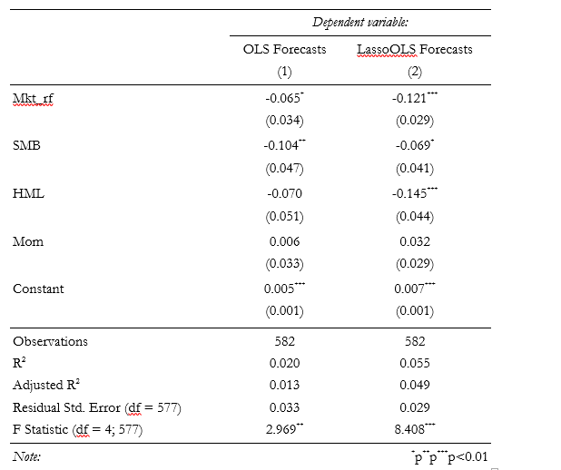
Do style factors explain the returns to the strategy?
Traditional style factors don’t explain the anomaly. Adj. R² is less than 0.05
Alpha of 70 bps per month or 8.4% annualized!

Slide 21
Why does Lasso do so much better than OLS?
Prediction Accuracy
Assume , and
then the prediction error of the estimate is:
OLS estimates have low bias but large variance (typically)
Lasso improves the overall prediction accuracy by sacrificing bias to reduce the variance of the predicted value.

Slide 22
A few caveats on the results
The results look good, but:
The Fama-French industry portfolios are not tradeable
Could we actually capture these returns?
We haven’t factored in transaction costs
Is portfolio turnover high in this strategy?
Machine learning is short on economic theory
Why are returns in the construction industry impacted by lagged industry returns in clothing industry?

Slide 23
Can we improve upon these findings?
At least, two types of data could potentially improve the model performance:
Industry momentum
Macroeconomic data

Slide 24
Random Forests

Slide 25
Random Forests
Random Forest Regressions are an “ensemble” algorithm that estimates a regression-type relationship between a numerical dependent variable and set of predictors.
An ensemble of Regression Trees
Similar to taking the average over large number of randomly selected regression trees

Slide 26
Regression Tree: Blood Pressure Example
Regression trees often used in biological and health sciences.
As an illustrative example let’s look at predicting blood pressure:
Regression: y = X β y = systolic blood pressure, X₁ = Age, X₂ = Weight
Whereas linear regression linearly projects dependent variable onto the space spanned by predictors, regression trees iteratively split the data in order to minimize mean squared errors as follows:

Slide 27
Internal nodes
Terminal nodes or leaves
There can be multiple observations
in each leaf (if desired)

Slide 28
Regression Tree
Starting with the set of data (“the trunk”), search over all explanatory variables and split values to determine which (variable, value) combination minimizes mean squared error the most.
Error: the difference between fitted values (average within each partitioned group) and actual dependent variable values
Once this optimal partition has been accomplished, the next iteration searches over all branches and chooses the single partition from among the entire set of branches to split just one of these branches in such a way that reduces the overall sum of squared errors the most.
This process is repeated until the desired number of leaves is attained.

Slide 29
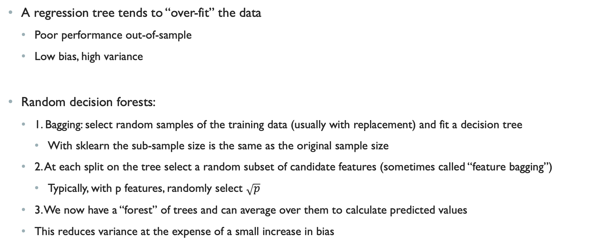
Random Decision Forests
A regression tree tends to “over-fit” the data
Poor performance out-of-sample
Low bias, high variance
Random decision forests:
1. Bagging: select random samples of the training data (usually with replacement) and fit a decision tree
With sklearn the sub-sample size is the same as the original sample size
2. At each split on the tree select a random subset of candidate features (sometimes called “feature bagging”)
Typically, with p features, randomly select $\sqrt{p}$
3. We now have a “forest” of trees and can average over them to calculate predicted values
This reduces variance at the expense of a small increase in bias

Slide 30
Making Predictions
How do we make a prediction for an observation ?
1. For each tree, we find the relevant leaf given the features of
Each leaf is the set of observations that “survived” or “failed” the same splits
2. Calculate the average y value for observations in that leaf
3. Average these values across trees to get the predicted

